Slide 1
Week 3a: Graphics pipeline

Slide 2
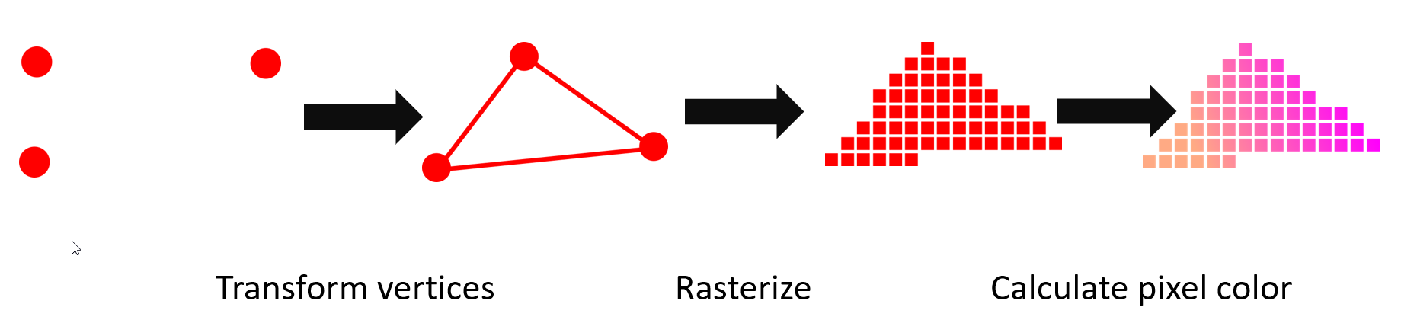
Last class
Raytracing vs Rasterization
GPU internals
Graphic API’s
HLSL (GPU language)
Forward/Deferred rendering

Slide 3
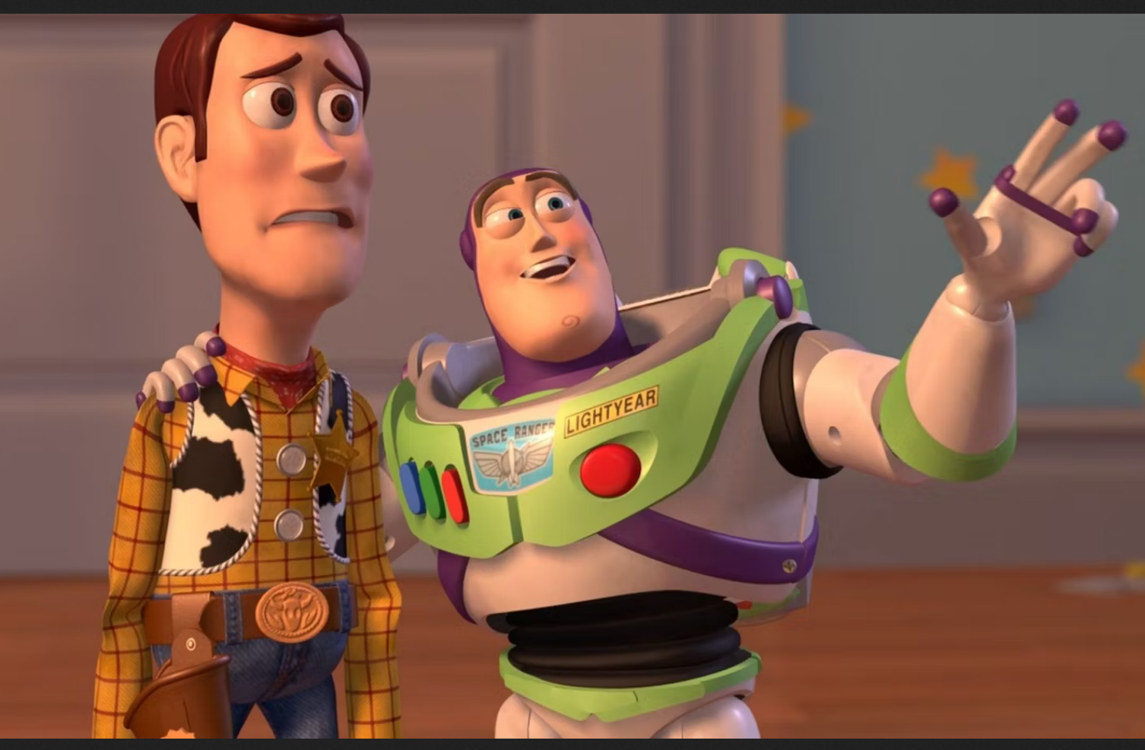
Course schedule
 | Monday | Thursday
Week 1 : 12/02 | Introduction | C#/Unity Lab
Week 2 : 19/02 | 3D reasoning | 3D Lab
Week 3 : 26/02 | Basic Pipeline | Lab
Week 4 : 04/03 | Textures Normal maps | Post processing / lab
Week 5 : 11/03 | Camera’s Light | lab
Week 6 : 18/03 | Advanced pipeline | Advanced pipeline lab
Week 7 : 25/03 | Materials Aliasing | Materials Lab
Week 8 : 15/04 | Procedural generation | Procedural generation lab
Week 9 : 22/04 | Project explanation | Project lab
Week 10 : 29/04 | Guest Lecture Project Labs | Guest Lecture Project Labs
Week 11 : | Revision | Revision
Highly likely to change ☹

Slide 4
This class
→ Texture basic ←
Texture types
Texture nuances
Example : color textures
Example : normal maps

Slide 5
Textures
Can someone tell me what they are?

Slide 6
Textures
Commonly : “a 2d grid of colors”
3d graphics : “spatially varying information”

Slide 7
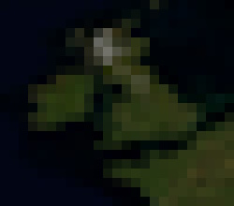
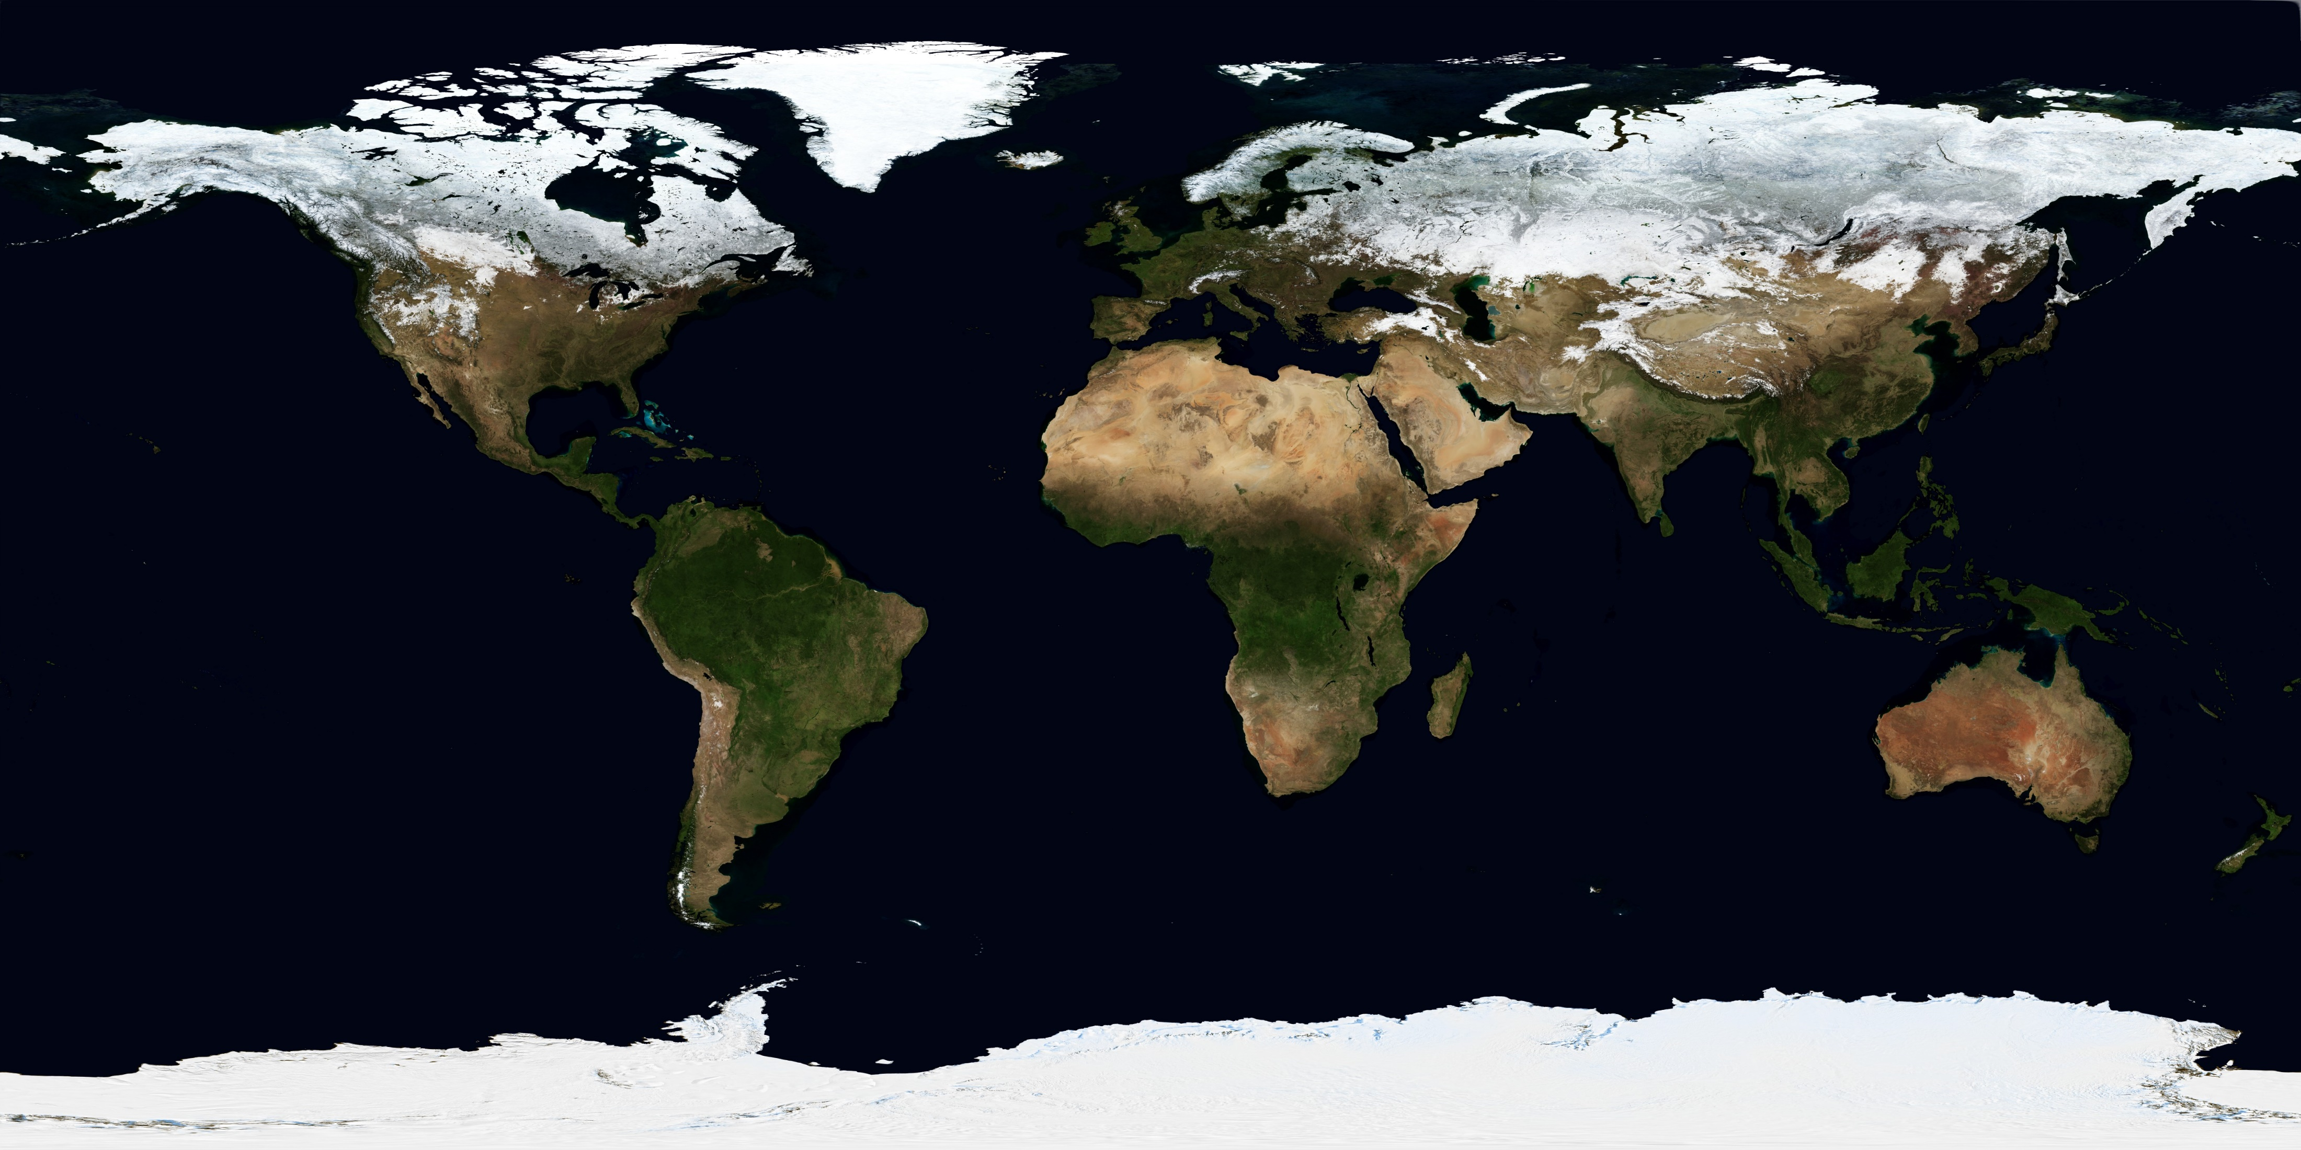
Textures : 2D grid of colors

Slide 8
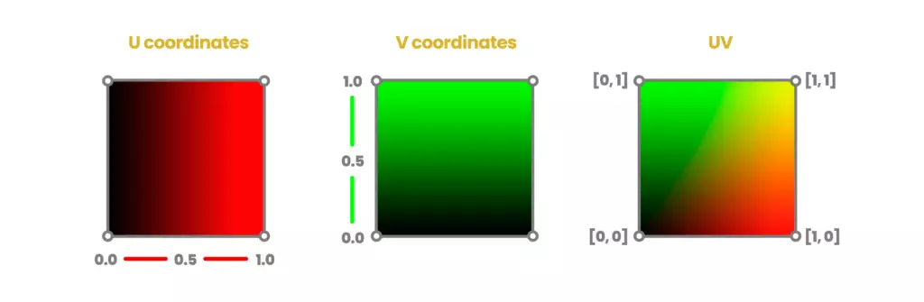
But we’re in 3D. How do we know the coordinates?
We use UV coordinates.
Vector2D, 0.0 -> 1.0 (typically)
They are part of the vertex

Slide 9
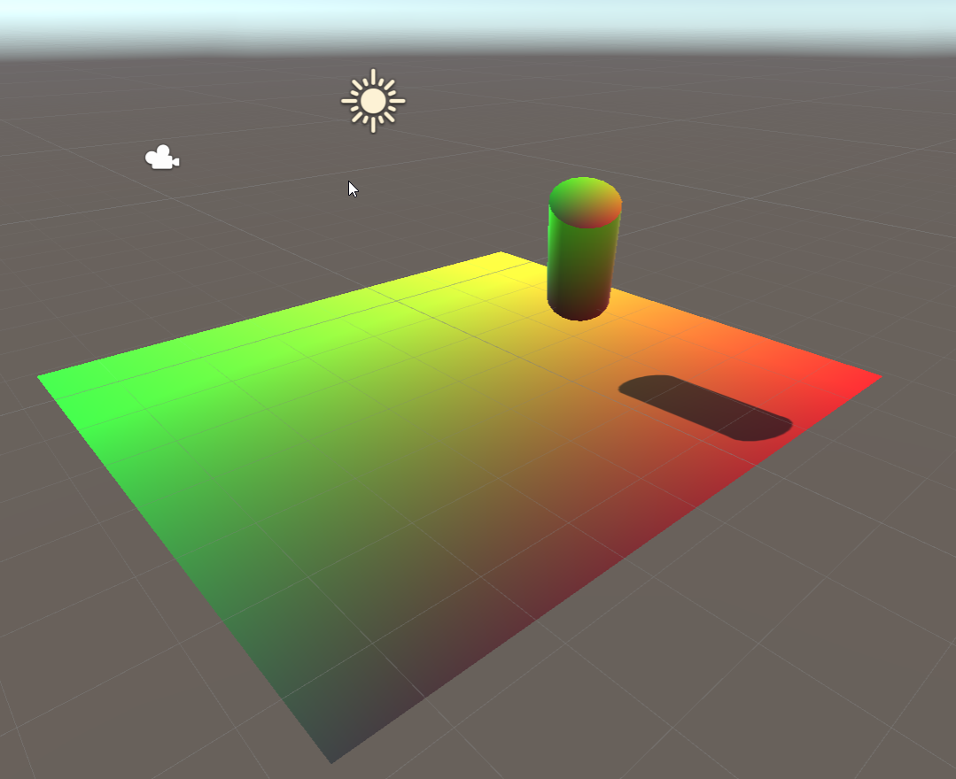
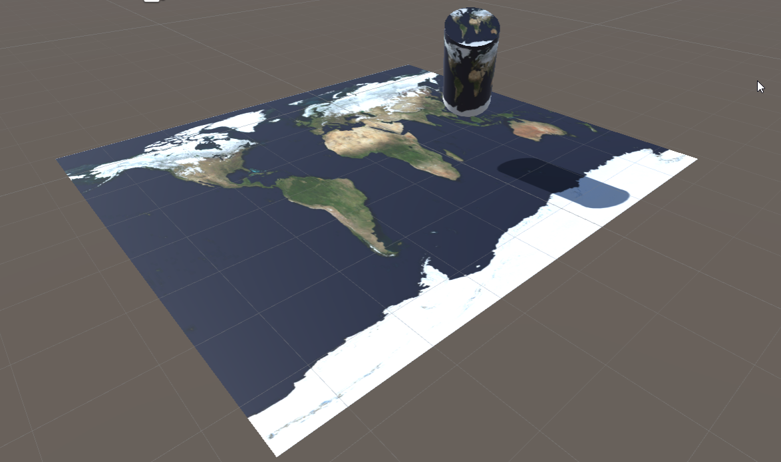
UV: float2 coordinates image: int2 coordinates
float2 uv(0,0) -> image[0,0]
float2 uv(1,1) -> image[width, height]

Slide 10
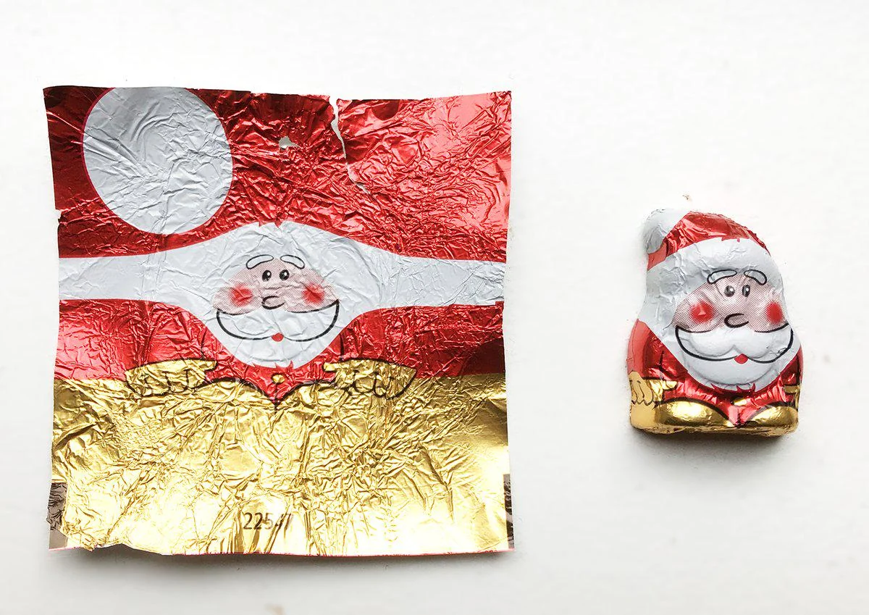

Slide 11
In code
// in Properties
_MainTex ("Albedo (RGB)", 2D) = "white" {}
// in SubShader
sampler2D _MainTex;
struct Input
{
float2 uv_MainTex;
}; // in fragment shader fixed4 color = tex2D (_MainTex, IN.uv_MainTex)

Slide 12
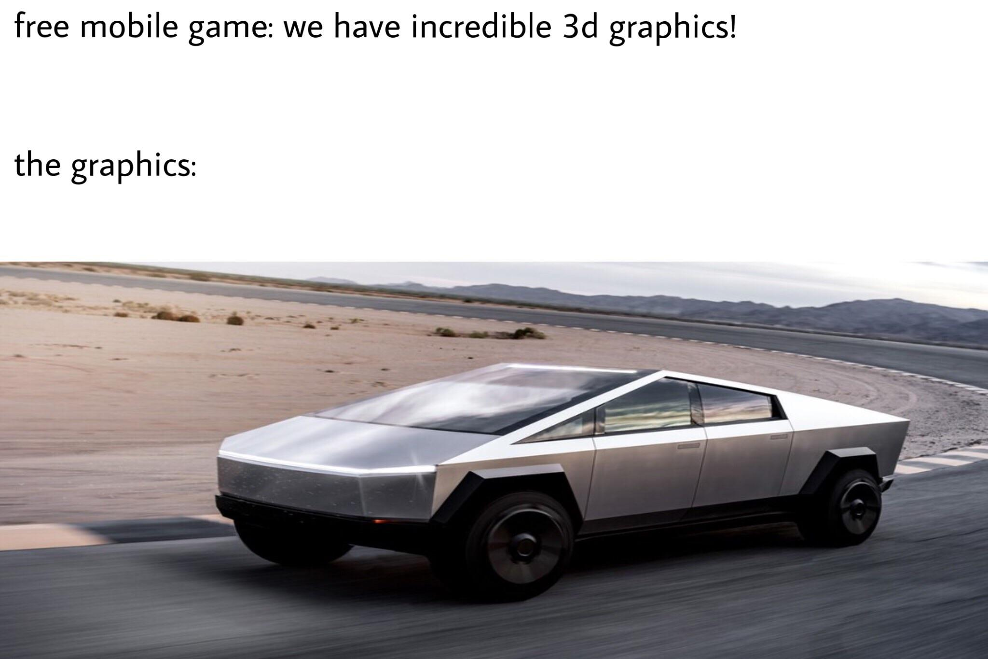
Any questions?

Slide 13
Texture basic
→ Texture types ←
Texture nuances
Example : color textures
Example : normal maps

Slide 14
We just saw Texture2D as an example
Anyone guess what the others are?

Slide 15
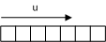
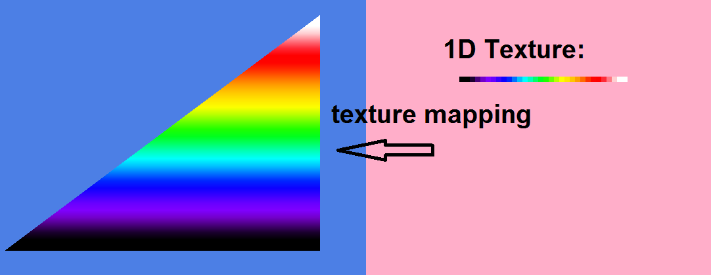
Texture 1D
Used for lookup tables
In practice, 2D textures anyway

Slide 16
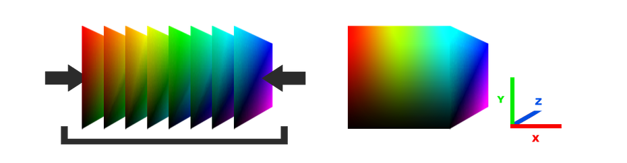
Texture3D
Has width, height, and depth
Need float3 uv’s
Gets large quick
Anyone have an example?

Slide 17
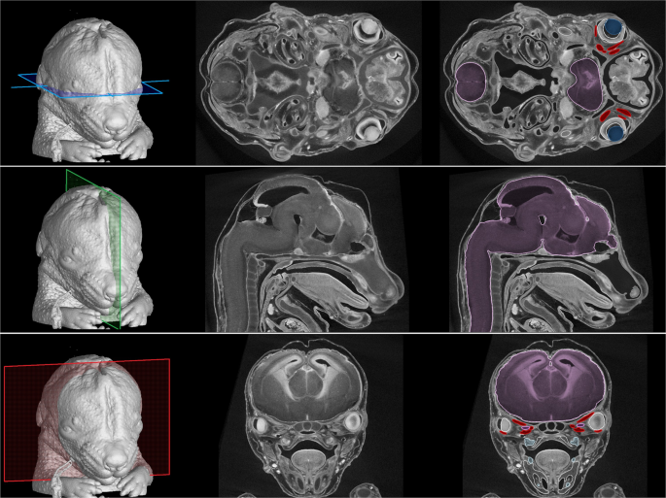

Slide 18
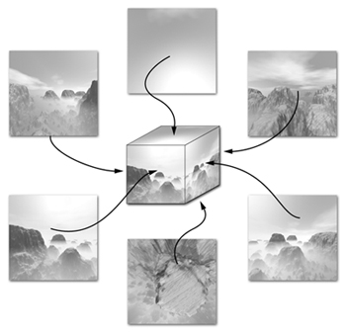
TextureCube
Resembles a six sided die
We index it with a direction
POV: center of the cube
Perfect for a skybox / reflections

Slide 19
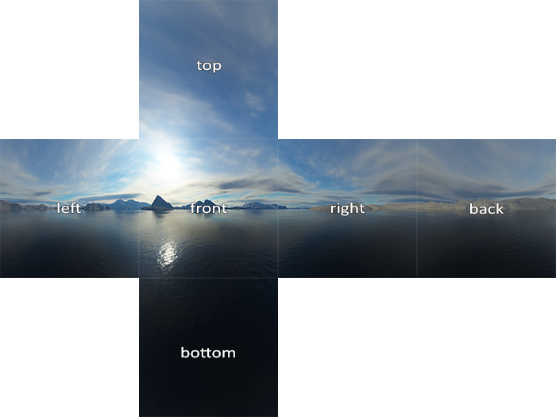

Slide 20
This class
Texture basic
Texture types
→Texture nuance ←
Example : color textures
Example : normal maps

Slide 21
Texture nuances
→ Borders ←
Mipmapping
Sampling

Slide 22
We said UV’s typically go 0.0->1.0
We can configure what happens when access the texture with uv coordinates going outside that range

Slide 23
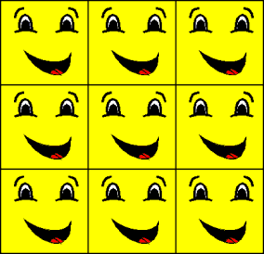
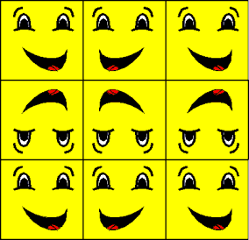
Wrap and mirror
Good for tiling textures
These are often used in terrain

Slide 24
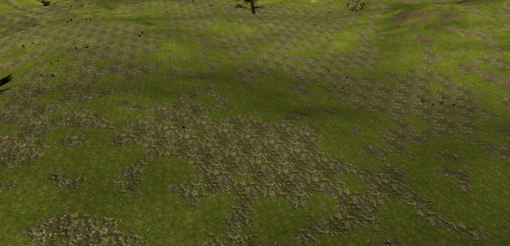

Slide 25
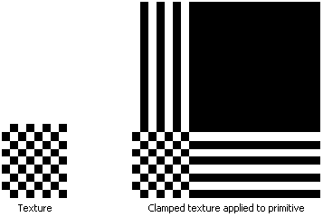
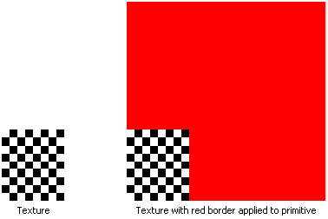
Clamp and border
Clamp is a good default
Border is good for finding bugs

Slide 26
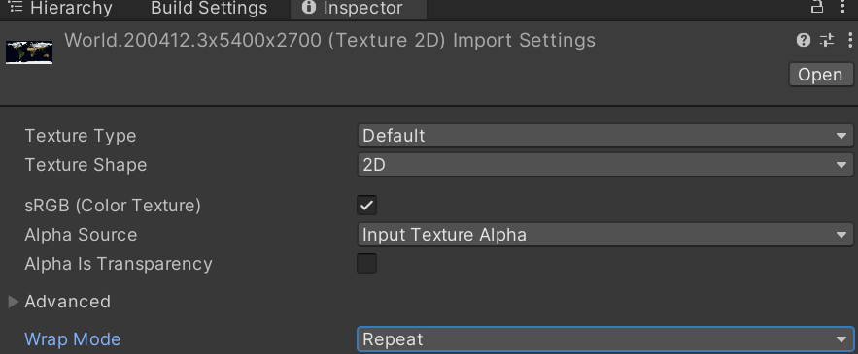
In unity, you can find this on your asset

Slide 27
Is everything clear?

Slide 28
Texture nuances
Borders
→ Mipmapping ←
Sampling

Slide 29
Textures have some problems
For faraway objects, we still need the entire texture in memory
For faraway objects, the full texture is too detailed, and creates aliasing (later class)

Slide 30
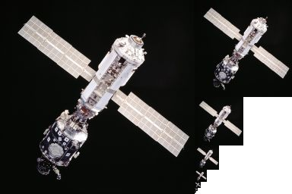
Solution
Create smaller versions iteratively
Often called a “pyramid”
Increases size by 50% (unless special implementation)
Worth it
Also for 1D, cube, and 3D

Slide 31
We don’t use this directly (in this course)
Unity handles a lot under the hood
Very important concept
We’ll see more in the aliasing class

Slide 32
Texture nuances
Borders
Mipmapping
→ Sampling ←

Slide 33
Sampling is also very important in 3D graphics
And easy to demonstrate in 2D textures
Imagine we have a 2x2 texture
Our uv (texcoord) is (.0, .4)
What pixel value should we take?

